Slide 1


Slide 2
Technology in Action
Chapter 7
Networking and Security:
Connecting Computers and Keeping
Them Safe from Hackers and Viruses
Notes:
Networks can increase the usefulness of computers. In this chapter, we’ll discuss networks, including home networks that share an Internet connection. Because networks are vulnerable to intrusion, we’ll also discuss computer threats, both what they are and how to prevent them.

Slide 3
Chapter Topics
Networking fundamentals
Network architecture
Network components
Peer-to-peer networks
Ethernet networks
Computer threats
Computer safeguards
Computer viruses
Notes:
Topics in Chapter 7 include:
Networking fundamentals
Network architecture
Network components
Peer-to-peer networks
Computer threats
Computer safeguards
Computer viruses

Slide 4
Networking Fundamentals
Computer network:
  Two or more computers connected together
  Devices connected to networks: nodes
Benefits of a network:
  Sharing resources
  Transferring files
Notes:
A computer network is simply two or more computers that are connected together via software and hardware so they can communicate.
Devices connected to a network are referred to as nodes. A node can be a computer, a peripheral (such as a printer), or a communications device (such as a modem).
The main function for most networks is to facilitate information sharing, but networks provide other benefits as well.
-they allow users to share peripherals
-you can transfer files from one computer to another without using external storage media
If you install a device called a router to your network, you can share broadband Internet connections.

Slide 5
Network Architecture
Network designs:
  Locally administered:
    Peer-to-peer (P2P)
  Centrally administered:
    Client/server
Notes:
There are two main ways a network can be administered (or run): locally or centrally. A peer-to-peer network is the most common example of a locally administered network. The most common type of centrally administered network is a client/server network.

Slide 6
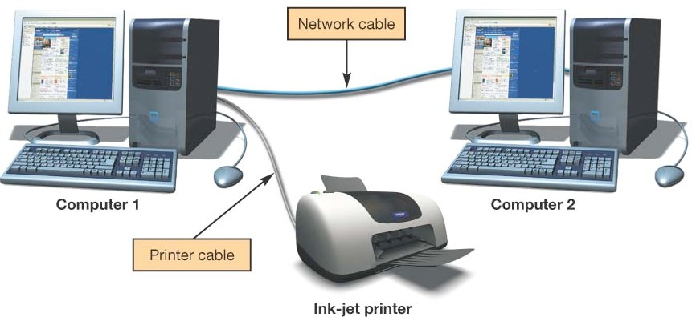
Peer-to-Peer Networks
Nodes communicate with each other:
  Peers
Share peripheral devices
Used in home and small office networks
Notes:
In peer-to-peer (P2P) networks, each node connected to the network can communicate directly with every other node on the network, instead of having a separate device exercise central control over the entire network.
Thus, all nodes on this type of network are in a sense peers.
When printing, for example, a computer on a P2P network doesn’t have to go through the computer that’s connected to the printer. Instead, it can communicate directly with the printer.
Because they are simple to set up, P2P networks are the most common type of home network.

Slide 7
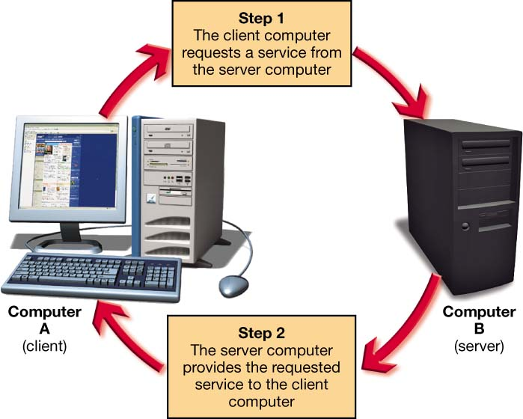
Client/Server Networks
Client computers:
  Users who make requests
Server computers:
  Provide resources to clients
  Central network control
Internet
  A large, multiserver,
  multiclient network.
Notes:
Most networks that have 10 or more nodes are client/server networks.
A client/server network contains two different types of computers: clients and servers.
The client is the computer on which users accomplish specific tasks and make specific requests.
The server is the computer that provides information or resources to the client computers on the network.
The server on a client/server network also provides central control for functions on the network (such as printing).
The Internet is a client/server network. When your computer is connected to the Internet, it is functioning as a client computer. When connecting to the Internet through an ISP, your computer connects to a server computer maintained by the ISP. The server “serves up” resources to your computer so that you can interact with the Internet.

Slide 8
LANs and WANs
Local area network (LAN):
  Nodes are within a small geographic region:
    Homes
    Schools
    Small businesses
Wide area network (WAN):
  LANs connected over long distances:
    A few miles to thousands of miles
    Use telecommunications lines
Notes:
The distance between nodes on a network is another way to describe a network.
Local area networks (LANs) are networks in which the nodes are located within a small geographic area. A network in your home or a computer lab at school is an example of a LAN.
Wide area networks (WANs) are made up of LANs connected over long distances. Say a school has two campuses located in different towns. Connecting the LAN at the east campus to the LAN at the west campus (by telecommunications lines) allows users on the two LANs to communicate with each other. The two LANs would be described as a single WAN.

Slide 9
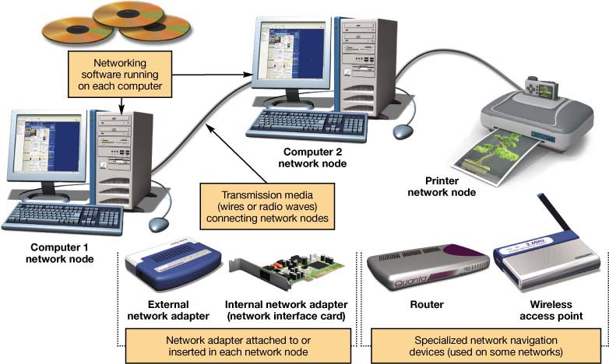
Network Components
Transmission media
Network communication devices
Software
Notes:
To function, all networks include
(a) a means of connecting the nodes on the network (by cables or wireless technology),
(b) special devices that allow the nodes to communicate with each other and to send data, and
(c) software that allows the network to run.

Slide 10
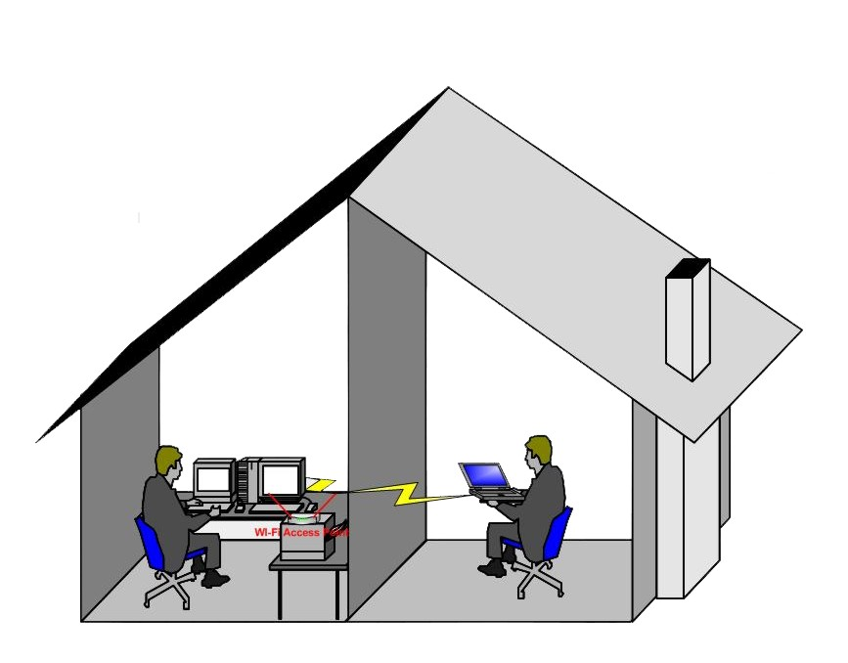
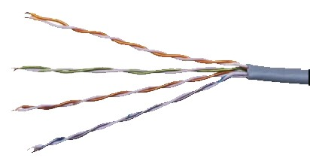
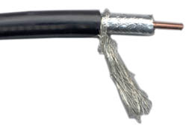
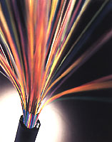
Transmission Media
Provides communications channel between nodes
Forms of media:
  Twisted pair
  Coaxial cable
  Fiber-optic cable
  Radio waves:
    Wireless
Bandwidth:
  Data transfer rate
  Throughput
Notes:
All network nodes are connected to each other and to the network by transmission media. A transmission medium establishes a communications channel between the nodes on a network and can take several forms:
Networks can use existing wiring (such as phone lines or power lines) to connect nodes.
Networks can use additional cable to connect nodes, such as twisted pair cable, coaxial cable, or fiber-optic cable.
Wireless networks use radio waves instead of wires or cable to connect nodes.
Data transfer rate (also called bandwidth) is the maximum speed at which data can be transmitted between two nodes on a network.
Throughput is the actual speed of data transfer that is achieved and is usually less than the data transfer rate.

Slide 11
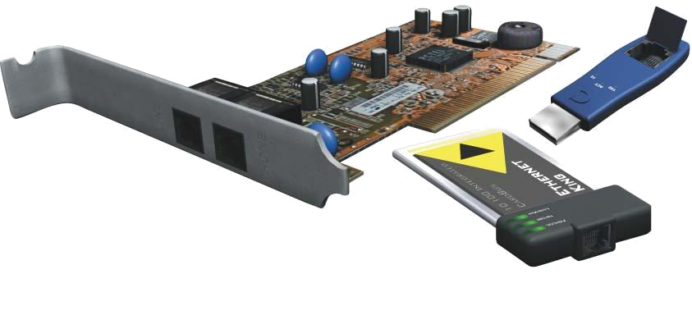
Network Adapters
Devices connected to or installed in nodes:
  Network interface cards (NICs)
  External network adapters
Enable communication between nodes
Notes:
Network adapters are devices connected to or installed in network nodes that enable the nodes to communicate with each other and to access the network.
Some network adapters take the form of external devices that plug into an available USB port.
Other network adapters are installed inside computers and peripherals as expansion cards. These adapters are referred to as network interface cards (NICs).

Slide 12
Network Navigation Devices
Devices that help make data flow possible
Routers:
  Route data between networks
Switches:
  Receive data and retransmit it to nodes on the same network
Notes:
Data is sent over transmission media in bundles called packets. For computers to communicate, these packets of data must be able to flow between computers. Network navigation devices help to make this data flow possible.
In simple networks, navigation devices are built right into network adapters. More sophisticated networks need specialized navigation devices.
The two most common specialized navigation devices are routers and switches.
-Routers transfer packets of data between two or more networks. For example, if a home network is connected to the Internet, a router is required to send data between the two networks.
-Switches receive data packets and send them to the node for which they are intended on the same network (not between different networks)

Slide 13
Networking Software
Peer-to-Peer Software
    Built into operating systems that support networking
      Windows
      Mac OS
Client/Server Software
    Network operating system (NOS) software
      Windows XP Professional
      Windows Server 2003
      Novell Netware
      Windows Vista Enterprise
Notes:
Home networks need OS software that supports peer-to-peer networking. The most common versions of Windows used in the home support P2P networking. You can connect computers running any of these OSs to the same network. The last several versions of the Mac OS also support P2P networking.
Client/server networks are controlled by a central server that has specialized network operating system (NOS) software installed on it. This software handles requests for information, Internet access, and the use of peripherals for the rest of the network nodes. Examples of NOS software include Windows XP Professional, Windows Server 2003, Novell Netware, and Windows Vista Enterprise.

Slide 14

Types of Peer-to-Peer Networks
Wired Ethernet networks
Wireless Ethernet networks
Power-line networks
Notes:
There are three main types of P2P networks:
1. Wired Ethernet networks
2. Wireless Ethernet networks
3. Power-line networks
The major differences in these networks are the transmission media by which the nodes are connected.

Slide 15
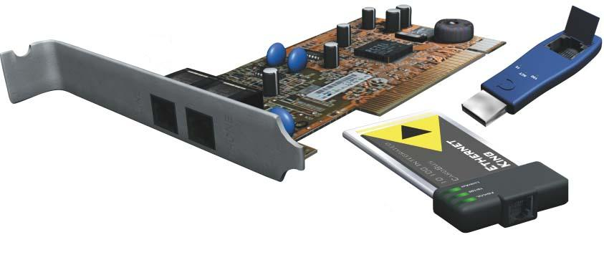
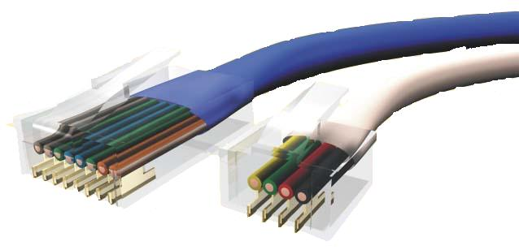
Wired Ethernet Networks
Ethernet network adapters are used to connect nodes
  NIC card
  PC Card
  USB adapter
Computers are connected to each other using unshielded twisted pair cable
Ethernet
Phone
Notes:
Ethernet networks use the Ethernet protocol as the means by which the nodes on the network communicate.
An Ethernet network requires that you install or attach network adapters to each computer or peripheral you want to connect to the network. Most computers come with Ethernet adapters preinstalled as network interface cards (NICs).
If your computer doesn’t have a NIC, you can buy one and install it, or you can use a USB adapter, which you plug into any open USB port on the system unit.
Although you can use USB versions in laptops, PC Card versions of Ethernet NICs are made especially for laptops.
The most popular transmission media option for wired Ethernet networks is unshielded twisted-pair (UTP) cable. UTP cable, used in telephone lines, is composed of four pairs of wires that are twisted around each other to reduce electrical interference.
UTP cable for Ethernet comes as Cat 5, Cat 5E, and Cat 6. Cat 5 has bandwidth up to 100 Mbps, Cat 5E up to 1,000 Mbps, and Cat 6 over 1 Gbps.

Slide 16
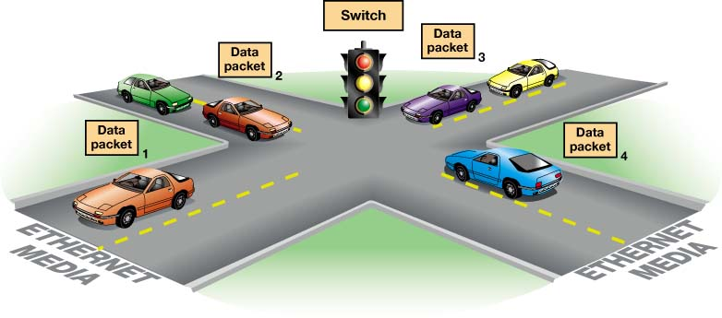
Ethernet Switches
Keep track of data packets
Amplify and retransmit signals
Keep the network running efficiently
Notes:
Data is transmitted through the wires of an Ethernet network in packets. Data packets can suffer collisions. If data packets collide, the data in them is damaged or lost. In either case, the network doesn’t function efficiently.
A switch in an Ethernet network acts like a traffic signal by enforcing the rules of the data road on the transmission media. The switch keeps track of the data packets and, in conjunction with NICs, helps the data packets find their destination without running into each other.

Slide 17
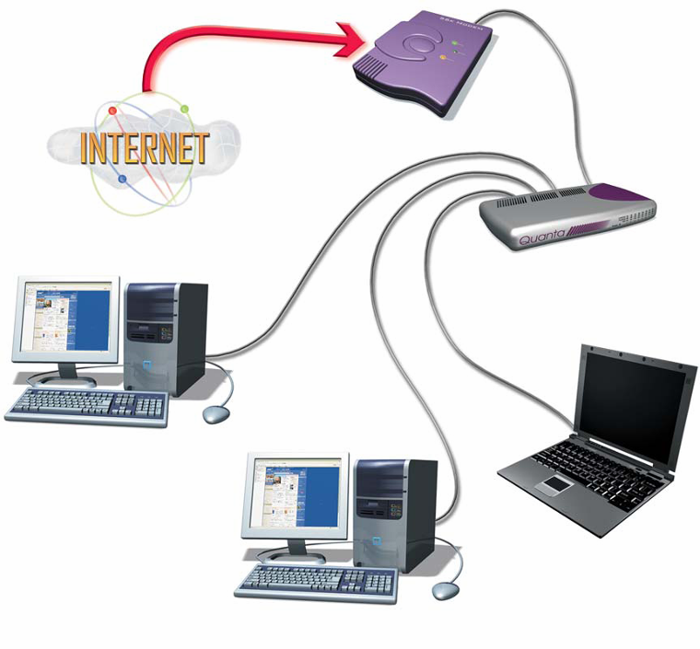
Ethernet Routers
Transfer packets from one network to another
Home Internet routers transfer data from the Internet to the home network.
Router
Notes:
Routers are devices that transfer packets of data between two or more networks. If a home network is connected to the Internet, you need a router to send data between the home network and the Internet.
Because so many people are sharing Internet access in home networks, manufacturers are making devices that combine switches and routers and are specifically designed to connect to DSL or cable modems. These are often referred to as DSL/cable routers.

Slide 18
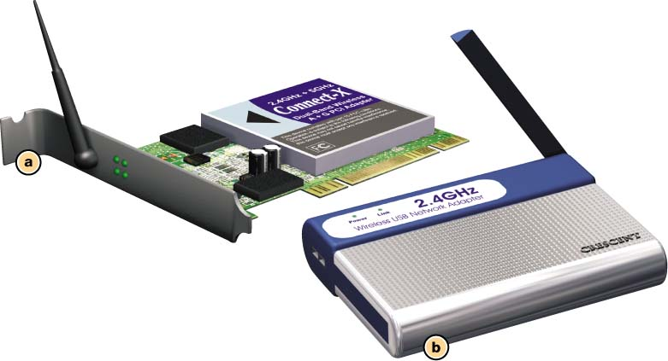
Wireless Ethernet Networks
Uses radio waves to connect nodes
Basically an Ethernet network that uses radio waves instead of wires
Each node requires a wireless network adapter:
  Transceivers
Notes:
A wireless network uses radio waves instead of wires or cables as its transmission media.
Current wireless networks in the United States are based on the 802.11 standard, which is also known as Wi-Fi (short for Wireless Fidelity).
Just like other networks, each node on a wireless network requires a wireless network adapter. These adapters are available as NICs that are inserted into expansion slots on the computer or as USB devices that plug into an open USB port.
Wireless network adapters differ from other network adapters in that they contain transceivers. A transceiver is a device that translates the electronic data that needs to be sent along the network into radio waves and then broadcasts these radio waves to other network nodes. Transceivers also receive the signals from other network nodes.

Slide 19
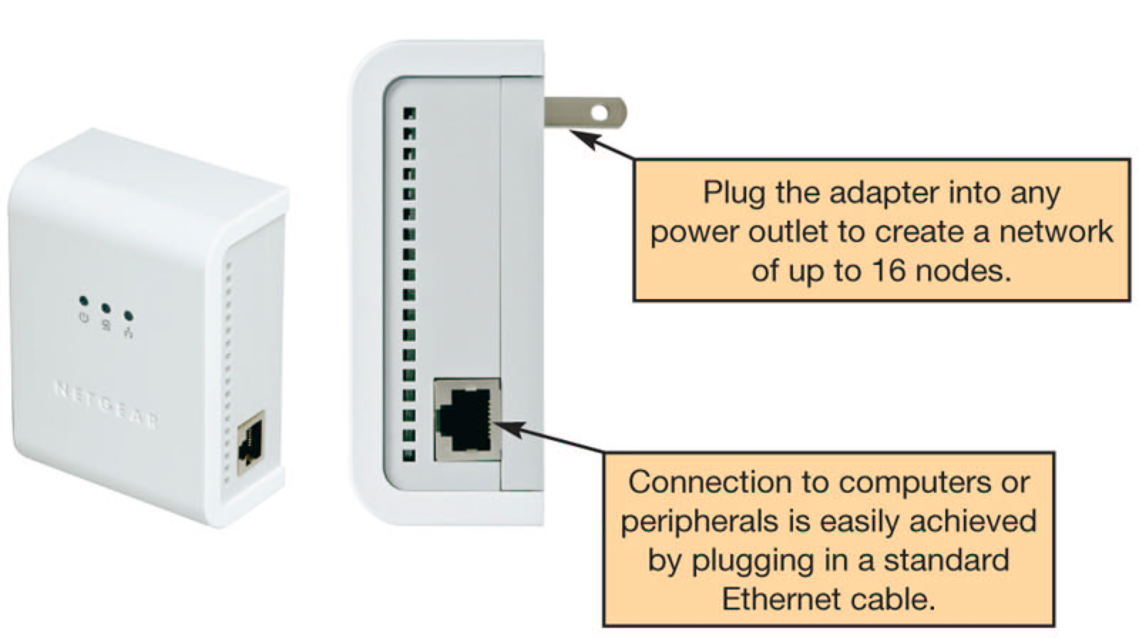
Power-Line Networks
Computers are connected to a house’s electrical wiring to create a network
Power-line network adapter is used to connect nodes to electrical outlets
Notes:
Power-line networks use the existing electrical wiring in your home to connect the nodes in the network.
In a power-line network, any electrical outlet provides a network connection. The original power line networks had a maximum data transfer rate of 14 Mbps. New standards provide for data transfer rates approaching 200 Mbps.
To create a power-line network, you connect a power-line network adapter to each computer or peripheral attached to the network. You plug the adapters into an electrical outlet. Most power-line network adapters will be automatically recognized by the Windows operating system.
Because of the low bandwidth of power-line networks and the lower costs of Ethernet networks, power-line networks have lost popularity. Higher data throughput of today’s power-line networks are bringing the idea back in focus.

Slide 20
Choosing a Peer-to-Peer Network
Things to consider:
  - Whether you want wireless communications
  - How fast you want your network connection to be
  - Whether existing wiring is available
  - How much money you can spend on your network
Comparing the Major Types of Home Networks
 | Wired Ethernet | Wireless 802.11g | Wireless Enhanced G | Wireless 802.11n
Maximum data Transfer rate (bandwidth) | 100 Mbps to 1,000 bps (1 gigabit) | 54 Mbps | 108 Mbps | 100 to 630 bps
Relative installation and equipment costs for networking two computers | $ | $ | $$ | $$$
Notes:
If you’re setting up a home network, the type of network you should choose depends on your particular needs. In general, consider the following factors in determining your network type:
Whether you want wireless communications.
How fast you want your network connection to be.
Whether existing wiring is available.
How much money you can spend on your network.

Slide 21
Configuring Software for a Home Network
Windows
  Windows Vista home versions
    Network setup wizard
      Wired or wireless
  Windows XP
    Network setup wizard
  Windows 98
    Configure manually
      Help has a clear instruction
Notes:
Once you install the hardware for your network, you need to configure your operating system software for networking on your computers.
Windows XP and the new Windows Vista makes configuring software relatively simple by providing the Network Setup Wizard for setting up wired networks. For wireless networks, Windows provides the Wireless Network Setup Wizard. You can launch both of these wizards from the Control Panel. Prior to running these wizards, you should do the following:
1. Install network adapters on each node.
2. For a wired network, plug all the cables into the router, network adapters, and so on.
3. Turn on all computers and peripherals (printers, scanners, and so on).
4. Make sure your cable/DSL modem is connected to your router and that it is connected to the Internet.
Completing these steps enables the wizards to make decisions about how best to configure your network.

Slide 22

Computer Threats
Cybercrimes are criminal acts conducted through the use of computers by cybercriminals.
Notes:
Cybercrime is formally defined as any criminal action perpetrated primarily through the use of a computer.
Cybercriminals are individuals who use computers, networks, and the Internet to perpetrate crime.
The existence of cybercrime means that computer users must take precautions to protect themselves.

Slide 23
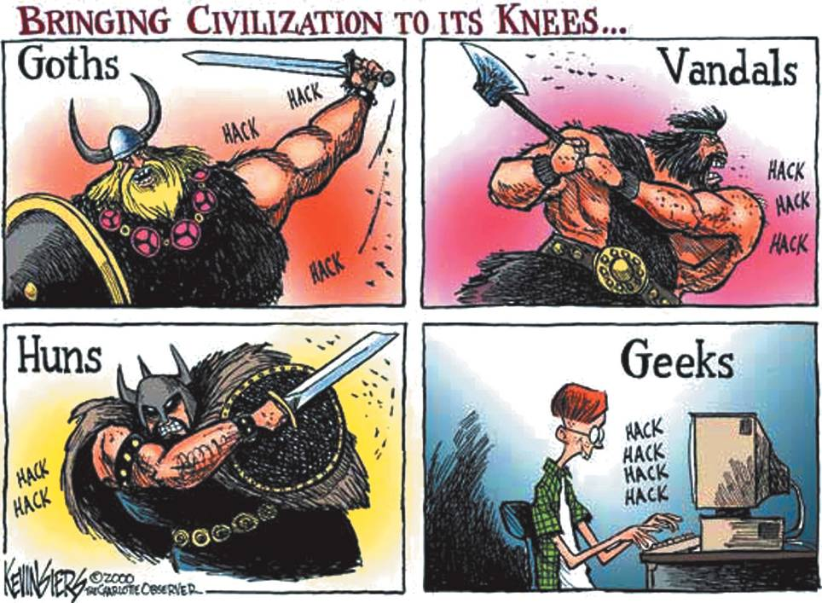
Hackers
Anyone who unlawfully accesses a computer system
Types of hackers:
  White-hat
  Black-hat
  Script kiddies
Notes:
A hacker is defined as anyone who breaks into a computer system (whether an individual computer or a network) unlawfully.
Many hackers who break into systems just for the challenge of it (and who don’t wish to steal or wreak havoc on the systems) refer to themselves as white-hat hackers. They tout themselves as experts who are performing a needed service for society by helping companies realize the vulnerabilities that exist in their systems.
White-hat hackers call hackers who use their knowledge to destroy information or for illegal gain black-hat hackers.
Amateur hackers are referred to as script kiddies. Script kiddies don’t create programs used to hack into computer systems; instead, they use tools created by skilled hackers.

Slide 24

What Hackers Do
Steal information from computers:
  Credit card numbers
  Bank account numbers
Internet packet sniffing
Commit identity theft
Notes:
If you perform financial transactions online, credit card and bank account information can reside on your hard drive and may be detectable by a hacker.
Even if this data is not stored on your computer, a hacker may be able to capture it when you’re online by using a packet sniffer. A packet sniffer is a program that looks at each packet as it travels on the Internet—not just those that are addressed to a particular computer, but all packets. Some packet sniffers are configured to capture all the packets into memory, whereas others capture only certain packets that contain specific content (such as credit card numbers).
Once a hacker has your credit card information, he or she can either use it to purchase items illegally or sell the number to someone who will. If hackers can gather enough information in conjunction with your credit card information, they may be able to commit identity theft.

Slide 25
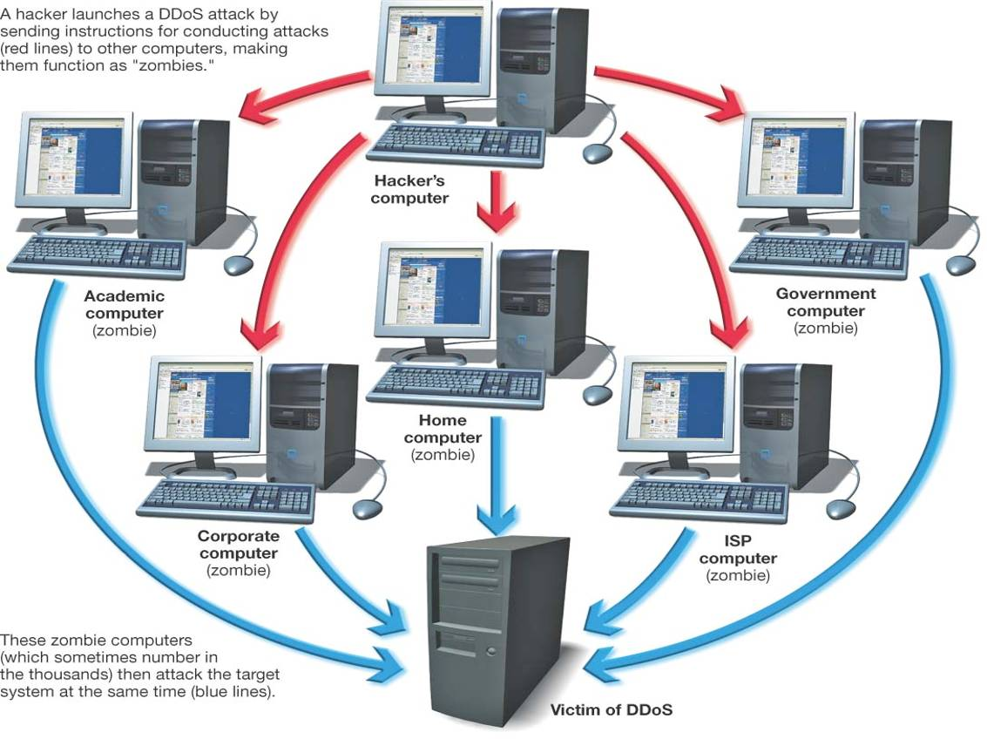
How Computers Are Attacked
Trojan horse
Backdoor program
  Zombies
Denial of service attacks
Notes:
To perpetrate widespread computer attacks, hackers need to control many computers at the same time. To this end, hackers often use Trojan horses to install other programs on computers.
A Trojan horse is a program that appears to be something useful or desirable (like a game or a screen saver), but at the same time does something malicious in the background without your knowledge.
Often, the malicious activity perpetrated by a Trojan horse program is the installation of backdoor programs, which allow hackers to take almost complete control of your computer without your knowledge. Using a backdoor program, hackers can access and delete all files on your computer, send e-mail, run programs, and do just about anything else you can do with your computer.
Computers that hackers control in this manner are referred to as zombies.
Hackers can also launch an attack from your computer called a denial of service (DoS) attack, in which legitimate users are denied access to a computer system because a hacker is repeatedly making requests of that computer system through a computer he or she has taken over as a zombie.

Slide 26
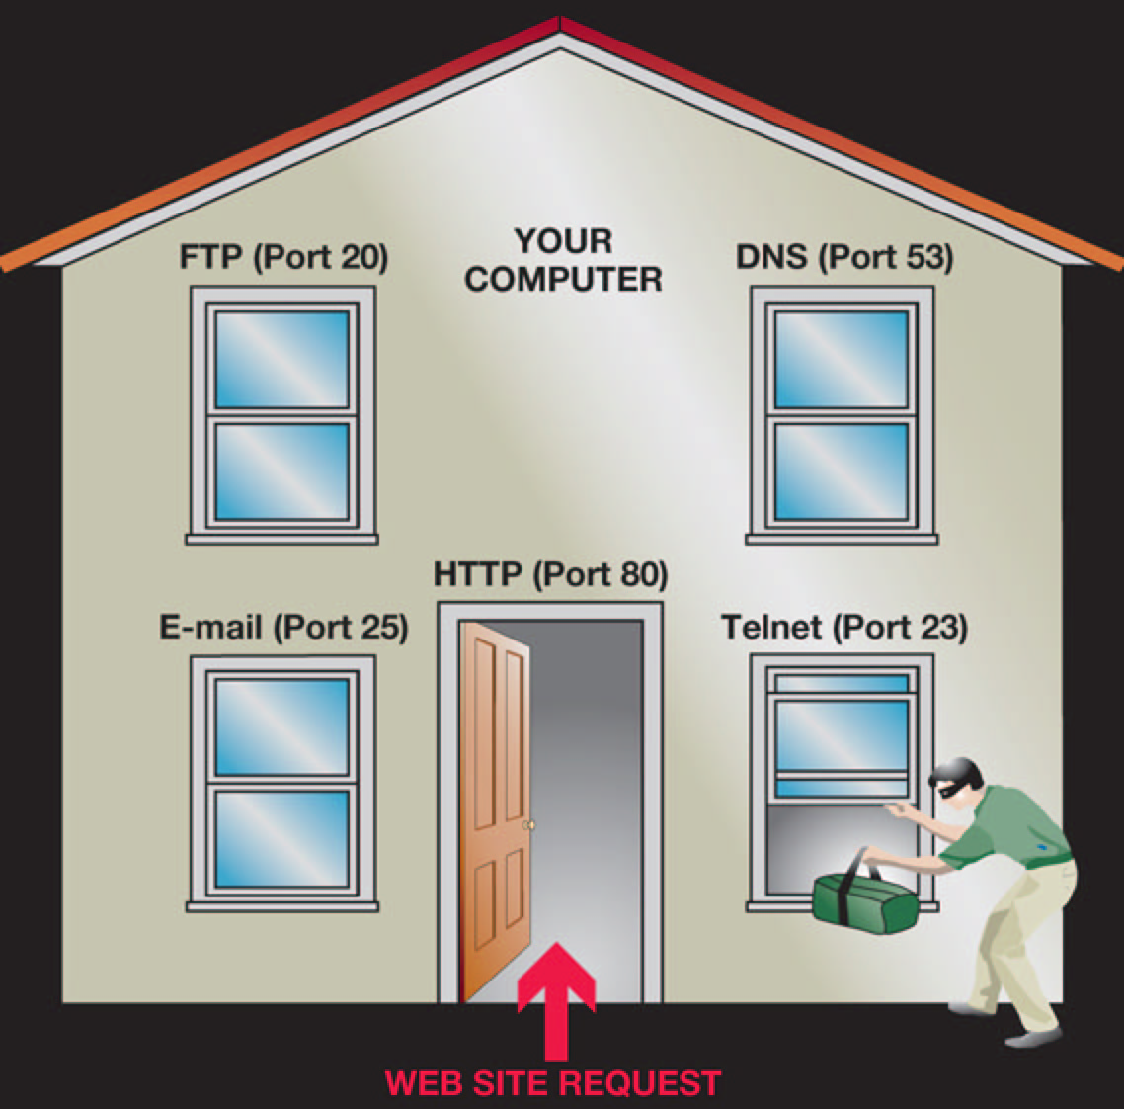
How Hackers Gain Access
Direct access:
  Hacking software
Indirect access:
  Internet connection
  Logical ports
Notes:
Hackers can gain access to computers directly or indirectly. Direct access involves sitting down at a computer and installing hacking software.
The most likely method a hacker will take to access a computer is indirectly through its Internet connection. When connected to the Internet, your computer is potentially open to attack by hackers.
Logical ports are virtual communications gateways that allow a computer to organize requests for information from other networks or computers. Open logical ports, like open windows in a home, invite intruders. Unless you take precautions to restrict access to your logical ports, other people on the Internet may be able to access your computer through them.

Slide 27
Computer Safeguards:
Firewalls
Software programs or hardware designed to close logical ports to invaders
  A firewall is built into Windows Vista
  More robust firewalls are available from other vendors
  Firewalls are critical if you have an always-on broadband connection
Notes:
Firewalls are software programs or hardware devices designed to keep computers safe from hackers.
By using a firewall, you can close off open logical ports to invaders and potentially make your computer invisible to other computers on the Internet.
Windows Vista includes a firewall.
The most popular software firewalls for the home include Norton Personal Firewall, McAfee Firewall, ZoneAlarm, and BlackICE PC Protection.
You can also buy and configure hardware firewall devices.

Slide 28
Protecting a Wireless Network
Wireless network range doesn’t stop at the property line
Default device and network ID settings allow intruders to enter the network
Internet bandwidth can be stolen
Computers can be vulnerable to hacker intrusion and takeover
Notes:
If you’re keeping a wired network secure with a firewall, you’re fairly safe from most hacker attacks. However, wireless networks have wide ranges, including areas outside of your house. This makes it possible for a hacker to access your network without you even knowing it.
Because your packets of information are being broadcast through the airwaves, a hacker can intercept and decode information from your transmissions that may allow him to bypass your firewall.
Others may steal your bandwidth and crimes can be committed through your network.
Therefore, to secure a wireless network, you should take the following additional precautions:
Change Your Network Name (SSID)
Disable SSID Broadcast
3. Change the Default Password on Your Router
Turn on Security Protocols
Implement Media Access Control
Apply Firmware Upgrades

Slide 29
Computer Threats: Viruses
A program that attaches itself to another program and spreads itself to other computers
Viruses are hidden within the code of a host program
Notes:
A computer virus is a computer program that attaches itself to another computer program (known as the host program) and attempts to spread itself to other computers when files are exchanged.
Viruses normally attempt to hide within the code of a host program to avoid detection. Viruses, by definition, have a method to spread.

Slide 30
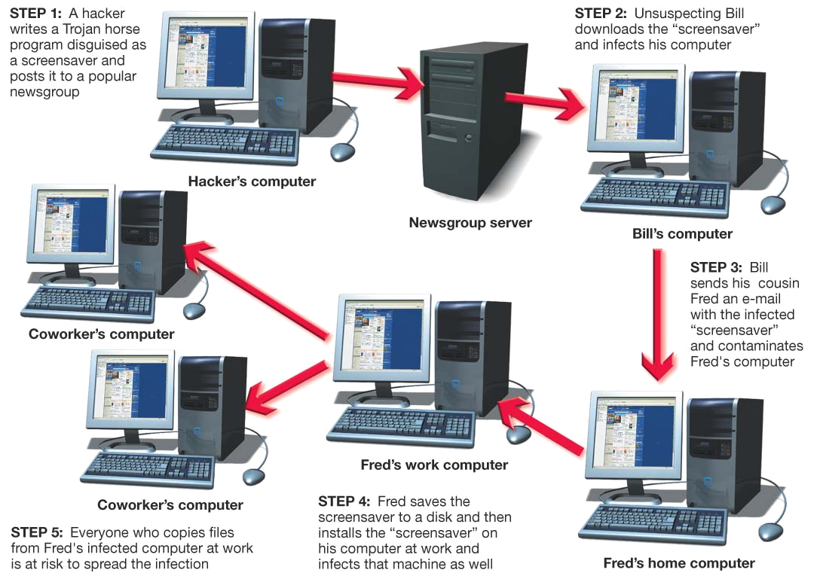
How Does a Computer
Catch a Virus?
Viruses copy themselves
Infect a file on your computer
Spread by sharing disks or flash drives
E-mail attachments are the most likely source of a virus
Notes:
If your computer is exposed to a file infected with a virus, the virus will try to copy itself and infect a file on your computer. If you never expose your computer to new files, it will not become infected. However, this would be the equivalent of a human being living in a bubble to avoid catching viruses.
Sharing disks or flash drives is a common source of virus infection, as is e-mail. Just opening an e-mail message will not infect your computer with a virus. Downloading or running a file that is attached to the e-mail is how your computer becomes infected.

Slide 31
What Viruses Do
Replicate themselves:
  Slow down networks
Secondary objectives:
  Display annoying messages
  Delete files on the hard drive
  Change computer settings
Notes:
A computer virus’s main purpose is to replicate itself and copy its code into as many other files as possible. Although virus replication can slow down networks, it is not usually the main threat.
The majority of viruses have secondary objectives or side effects, ranging from displaying annoying messages on the computer screen to the destruction of files or the contents of entire hard drives.

Slide 32
Types of Viruses
Boot-sector viruses
  Replicate themselves in the boot sector of the hard drive
Logic bombs
  Activate when certain conditions are met
Time bombs
  Viruses that are triggered by the passage of time or on a certain date
Worms
  Travel between systems through networks
Notes:
Although thousands of computer viruses and variants exist, they can be grouped into broad categories based on their behavior and method of transmission.
Boot-sector viruses replicate themselves into the hard drive’s Master Boot Record, a program that executes whenever a computer boots up, ensuring that the virus is loaded immediately. Boot-sector viruses are often transmitted by a floppy disk left in a floppy drive. or a flash drive left in a USB port. Boot-sector viruses can erase your entire hard drive.
Logic bombs are viruses that are triggered when certain logical conditions are met (such as opening a file). Time bombs are viruses that are triggered by the passage of time or on a certain date. The effects of logic bombs and time bombs range from annoying messages being displayed on the screen to reformatting of the hard drive, causing complete data loss.
Worms attempt to travel between systems through networks to spread their infections.

Slide 33
Types of Viruses
Script viruses:
  Hidden on Web pages as mini programs
Macro viruses:
  Attached to documents
  Series of commands
E-mail virus
  Use e-mail address book to distribute the virus
Encryption viruses
  Compresses files using a complex encryption key
  User must pay to get the files unlocked
Notes:
Some viruses are hidden on Web sites in the form of scripts. Scripts are mini programs that are often used to perform legitimate functions on Web sites. However, some scripts are malicious. For example, say you receive an e-mail encouraging you to visit a Web site full of useful programs and information. Unbeknownst to you, clicking a link to display a video runs a script that infects your computer with a virus.
Macro viruses are attached to documents (such as Word files) that use macros. A macro is a short series of commands that usually automates repetitive tasks. However, macro languages are now so sophisticated that viruses can be written with them.
E-mail viruses use the address book in the victim’s e-mail system to distribute the virus.
Encryption viruses search for common data files and then compress them using a complex encryption key. The user then has to pay to get the file unlocked.

Slide 34
Virus Classifications
Polymorphic viruses:
  Periodically rewrite themselves to avoid detection
Multipartite viruses:
  Infect multiple file types
Stealth viruses:
  Erase their code from the hard drive and reside in the active memory
Notes:
Viruses can also be classified by the methods they take to avoid detection by antivirus software:
Polymorphic viruses change their own code (or periodically rewrite themselves) to avoid detection. Most polymorphic viruses infect one certain type of file (.exe files, for example).
Multipartite viruses are designed to infect multiple file types in an effort to fool the antivirus software that is looking for them.
Stealth viruses temporarily erase their code from the files where they reside and hide in the active memory of the computer. This helps them avoid detection if only the hard drive is being searched for viruses.
.

Slide 35
Antivirus Software
Programs designed to detect viruses:
  Scan files looking for virus signatures (unique code)
  Provide options for deleting or fixing infected files
  Inoculate files against further infection
Detect known viruses
Antivirus programs need to be updated frequently
Notes:
The best defense against viruses is to install antivirus software, which is specifically designed to detect viruses and protect your computer and files from harm.
Most antivirus software looks for virus signatures in files. Signatures are portions of the virus code that are unique to a particular computer virus. Antivirus software scans files for these signatures and thereby identifies infected files and the type of virus that is infecting them.
The antivirus software scans files when they’re opened or executed. If it detects a virus signature or suspicious activity, it stops the execution of the file and notifies you it has detected a virus. Usually it gives you the choice of deleting or repairing the infected file and places the virus in a secure area. This is called quarantining.
Inoculating is when an antivirus program records key attributes about files and re-checks these statistics during a scan.
Antivirus software catches known viruses effectively. Thus, your computer can still be attacked by a virus that your antivirus software doesn’t recognize. To minimize this risk, you should keep your antivirus software up-to-date.

Slide 36
Chapter 7 Summary Questions
What is a network, and what are the advantages of setting up one?
Notes:
What is a network, and what are the advantages of setting up one?

Slide 37
Chapter 7 Summary Questions
What is the difference between a client/server network and a peer-to-peer network?
Notes:
What is the difference between a client/server network and a peer-to-peer network?

Slide 38
Chapter 7 Summary Questions
What are the main components of every network?
Notes:
What are the main components of every network?

Slide 39
Chapter 7 Summary Questions
What are the most common home networks?
Notes:
What are the most common home networks?

Slide 40
Chapter 7 Summary Questions
What are wired Ethernet networks, and how are they created?
Notes:
What are wired Ethernet networks, and how are they created?

Slide 41
Chapter 7 Summary Questions
What are wireless Ethernet networks, and how are they created?
Notes:
What are wireless Ethernet networks, and how are they created?

Slide 42
Chapter 7 Summary Questions
How are power-line networks created, and are they viable alternatives to Ethernet networks?
Notes:
How are power-line networks created, and are they viable alternatives to Ethernet networks?

Slide 43
Chapter 7 Summary Questions
How can hackers attack a network, and what harm can they cause?
Notes:
How can hackers attack a network, and what harm can they cause?

Slide 44
Chapter 7 Summary Questions
What is a firewall, and how does it keep my computer safe from hackers?
Notes:
What is a firewall, and how does it keep my computer safe from hackers?

Slide 45
Chapter 7 Summary Questions
Why are wireless networks more vulnerable than wired networks, and what special precautions are required to ensure my wireless network is secure?
Notes:
Why are wireless networks more vulnerable than wired networks, and what special precautions are required to ensure my wireless network is secure?

Slide 46
Chapter 7 Summary Questions
From which types of viruses do I need to protect my computer?
Notes:
From which types of viruses do I need to protect my computer?

Slide 47
Chapter 7 Summary Questions
What can I do to protect my computer from viruses?
Notes:
What can I do to protect my computer from viruses?

